Slide 1

7th Grade Math
Unit 10, Lesson 4 Solving One-Step Inequalities Using Multiplication and Division Volume 2, pg. 104

Slide 2


Benchmark
MA.7.AR.2.1
Write and solve one-step inequalities in one variable within a mathematical context and represent solutions algebraically or graphically.
volume 2, pg. 104

Slide 3
Integrated Mathematical Thinking and Reasoning Standards
MA.K12.MTR.1.1 Actively participate in effortful learning both individually and collectively.
MA.K12.MTR.2.1 Demonstrate understanding by representing problems in multiple ways.
MA.K12.MTR.4.1 Engage in discussions that reflect on the mathematical thinking of self and others.
MA.K12.MTR.5.1 Use patterns and structure to help understand and connect mathematical concepts.
volume 2, pg. 104

Slide 4

Learning Targets
I can solve one-step inequalities in one variable using multiplication or division.
I can relate properties of inequality to solving one-step inequalities algebraically.
volume 2, pg. 104

Slide 5

Warm-Up
volume 2, pg. 104

Slide 6
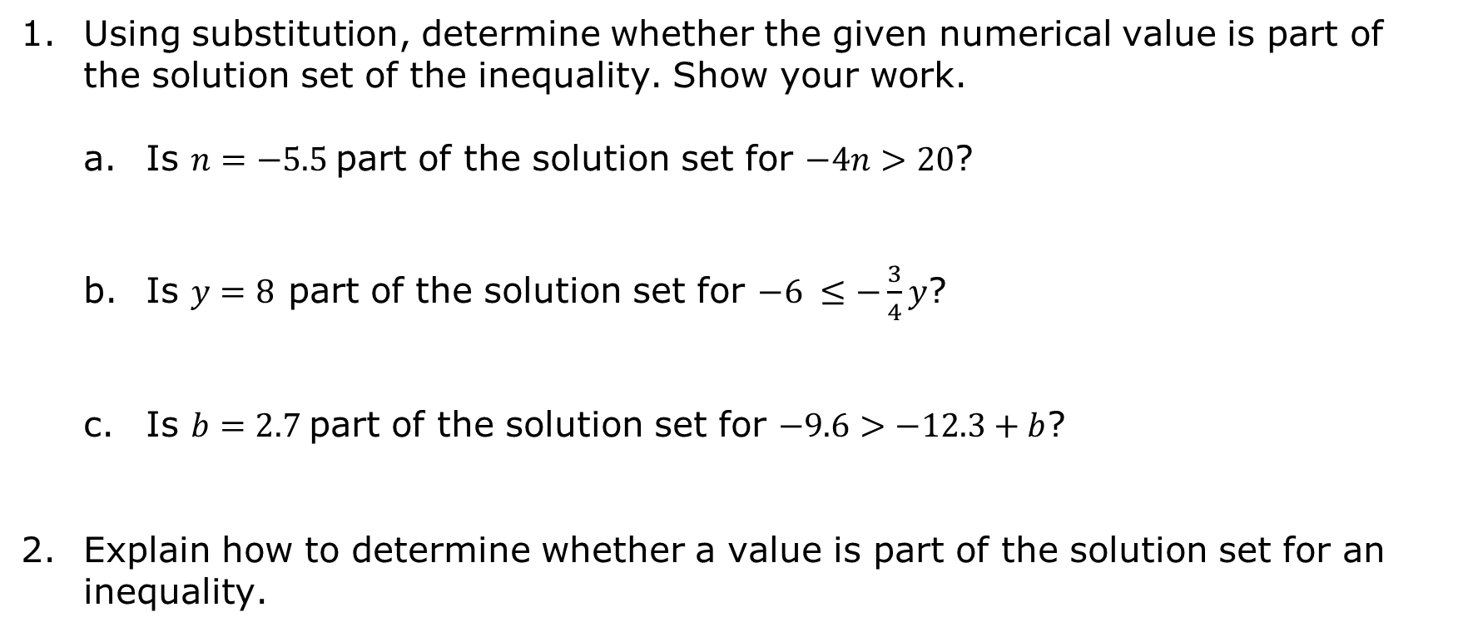
10.4.1 Warm-Up: Bell Work
Using substitution, determine whether the given numerical value is part of the solution set of the inequality. Show your work.
Is $n=−5.5$ part of the solution set for $−4n>20$?
Is $y=8$ part of the solution set for $−6 ≤−\frac{3}{4}y$?
Is $b=2.7$ part of the solution set for $−9.6>−12.3+b$?
Explain how to determine whether a value is part of the solution set for an inequality.
volume 2, pg. 104

Slide 7

Collaboration
volume 2, pg. 105

Slide 8

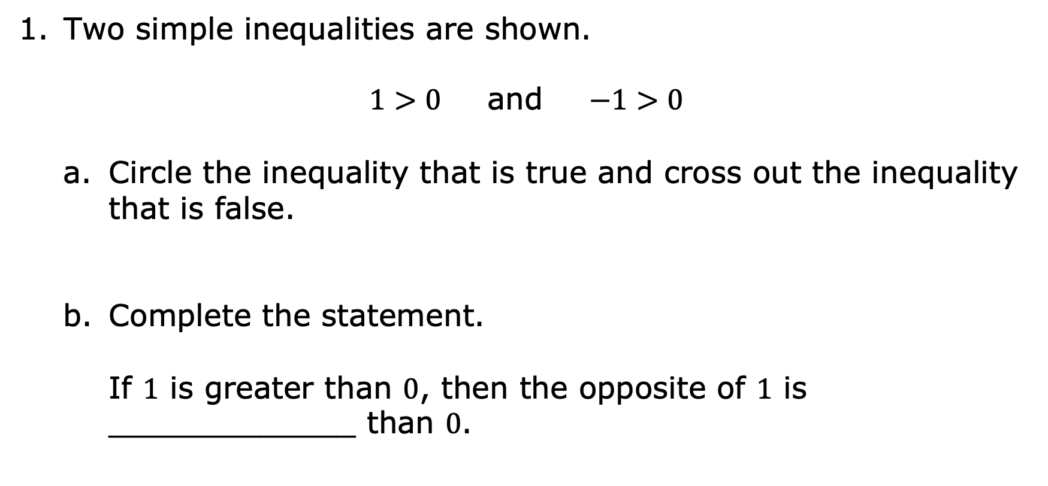
10.4.2 Collaboration: The Effect of a Negative Coefficient
Two simple inequalities are shown.
$1>0$ and $−1>0$
Circle the inequality that is true and cross out the inequality that is false.
Complete the statement.
If $1$ is greater than $0$, then the opposite of $1$ is _____________ than $0$.
volume 2, pg. 105

Slide 9
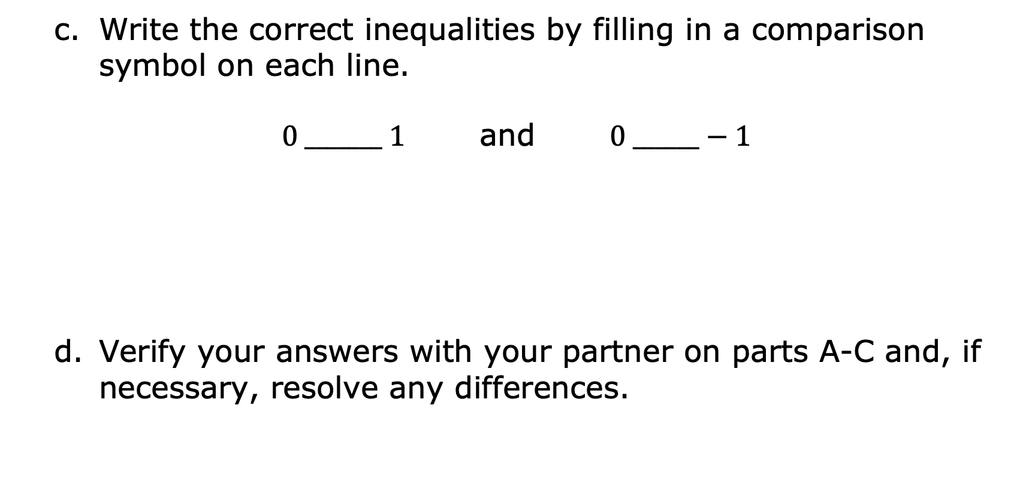
Write the correct inequalities by filling in a comparison symbol on each line.
$0 _______ 1$ and $0 ______−1$
Verify your answers with your partner on parts A-C and, if necessary, resolve any differences.
volume 2, pg. 105

Slide 10
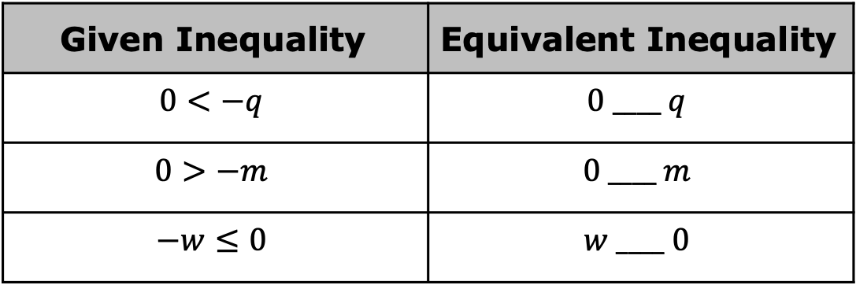
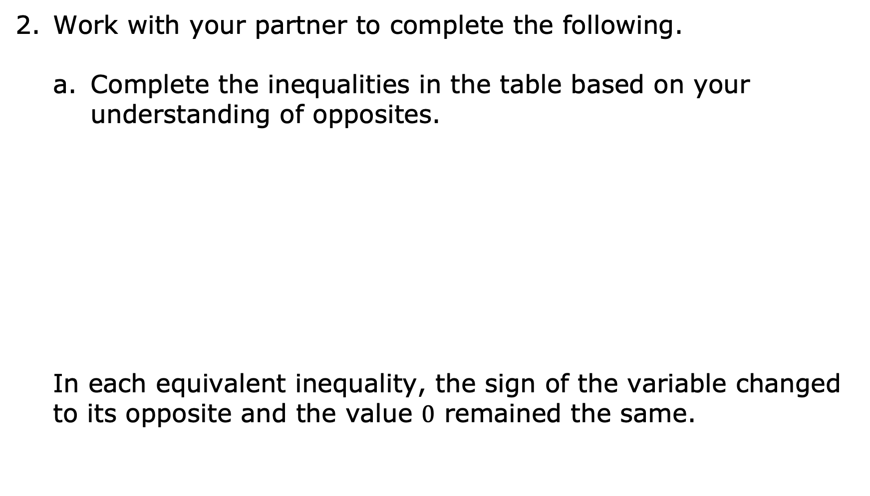
Work with your partner to complete the following.
Complete the inequalities in the table based on your understanding of opposites.
In each equivalent inequality, the sign of the variable changed to its opposite and the value $0$ remained the same.
Given Inequality | Equivalent Inequality
$$0<−q$$ | $$0 ____ q$$
$$0>−m$$ | $$0 ____ m$$
$$−w≤0$$ | $$w ____ 0$$
volume 2, pg. 105

Slide 11
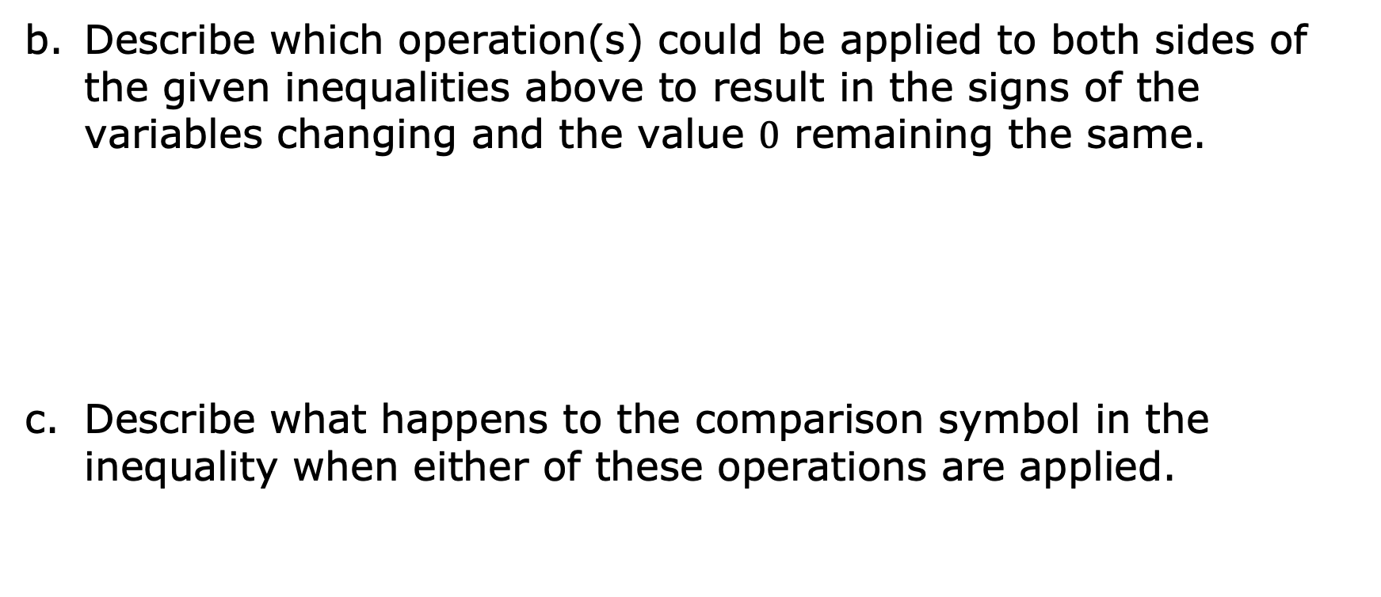
Describe which operation(s) could be applied to both sides of the given inequalities above to result in the signs of the variables changing and the value $0$ remaining the same.
Describe what happens to the comparison symbol in the inequality when either of these operations are applied.
volume 2, pg. 105

Slide 12

Bring It Together
volume 2, pg. 106

Slide 13

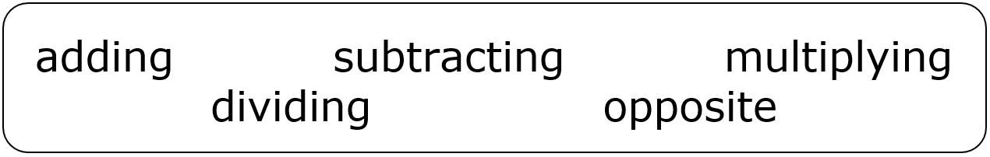
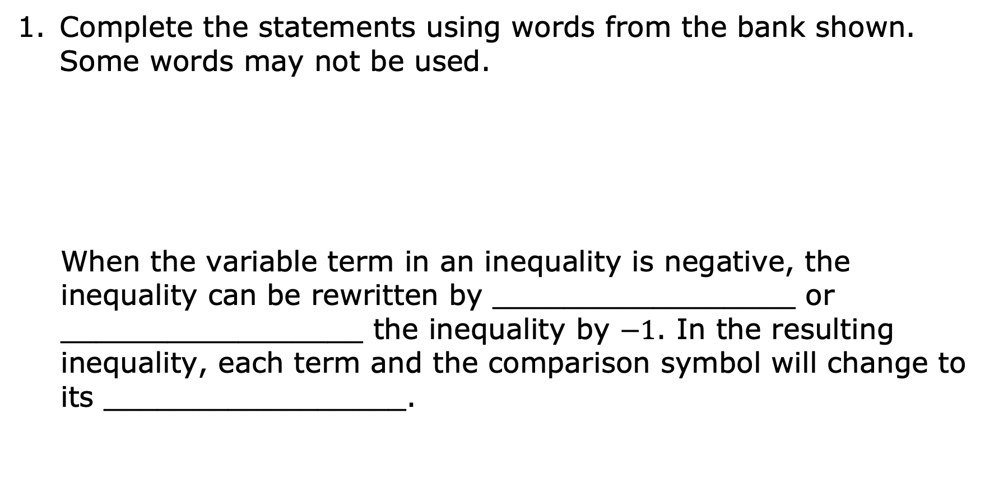
10.4.3 Bring It Together: The Effect of a Negative Coefficient
Complete the statements using words from the bank shown. Some words may not be used.
When the variable term in an inequality is negative, the inequality can be rewritten by _________________ or _________________ the inequality by $−1$. In the resulting inequality, each term and the comparison symbol will change to its _________________.
volume 2, pg. 106

Slide 14

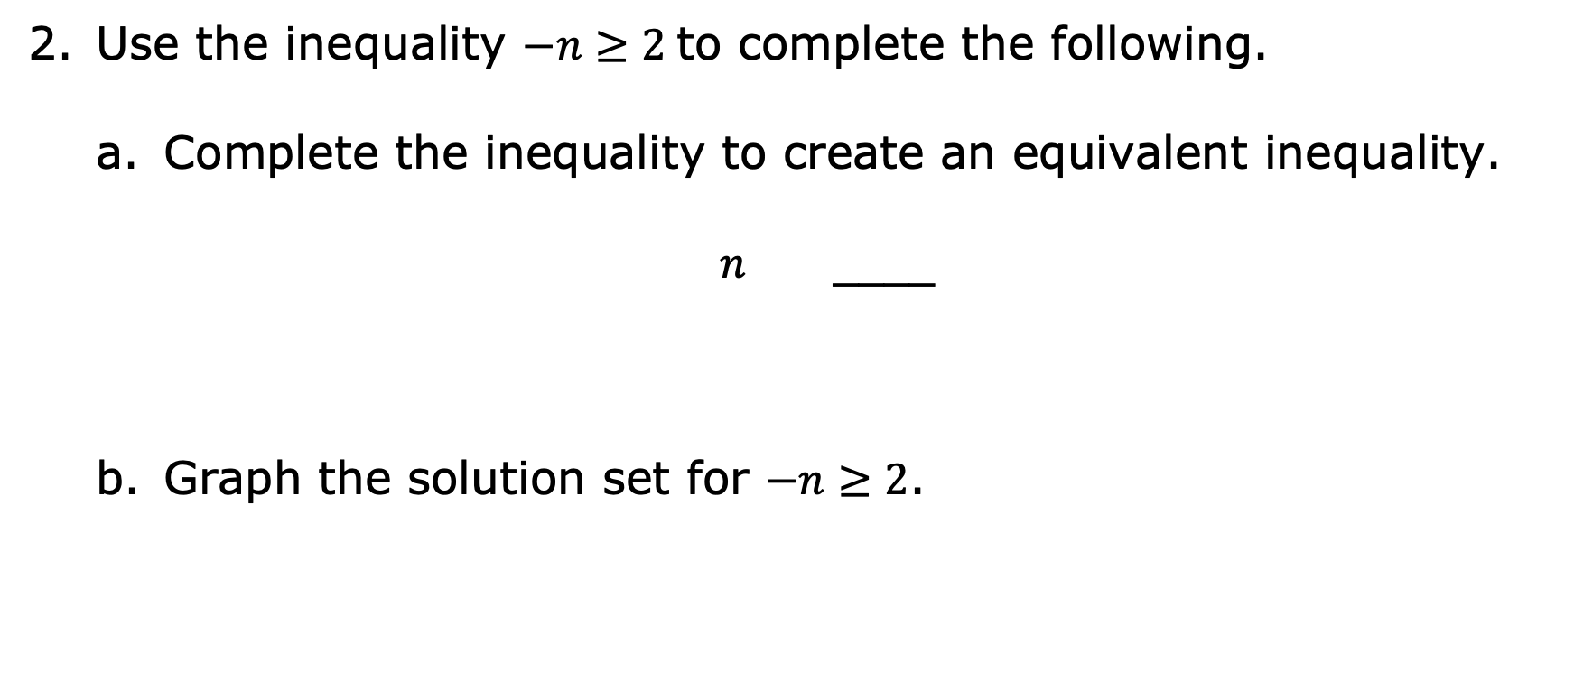
Use the inequality $−n≥2$ to complete the following.
Complete the inequality to create an equivalent inequality.
$n$ ____
Graph the solution set for $−n≥2$.
volume 2, pg. 106

Slide 15

Guided Instruction
volume 2, pg. 106

Slide 16

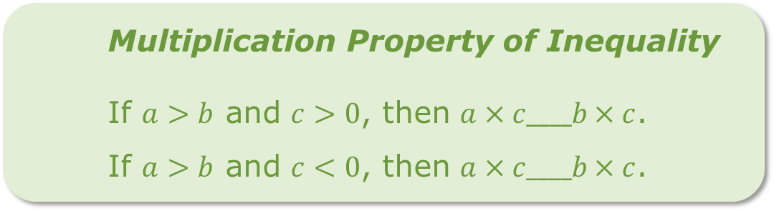
10.4.4 Guided Instruction: Solving One-Step Inequalities with Multiplication and Division
As with solving one-step inequalities with addition and subtraction, properties of inequality can be used to solve inequalities with multiplication and division. As discovered in the Collaboration, though, when the value that is being multiplied or divided is negative, this changes both the values in the inequality and the comparison symbol to their opposites.
Multiplying both sides of an inequality by the same value can be used to solve an inequality by the multiplication property of inequality.
Multiplication Property of Inequality
If $a>b$ and $c>0$, then $a×c____b×c$.
If $a>b$ and $c<0$, then $a×c____b×c$.
volume 2, pg. 106

Slide 17
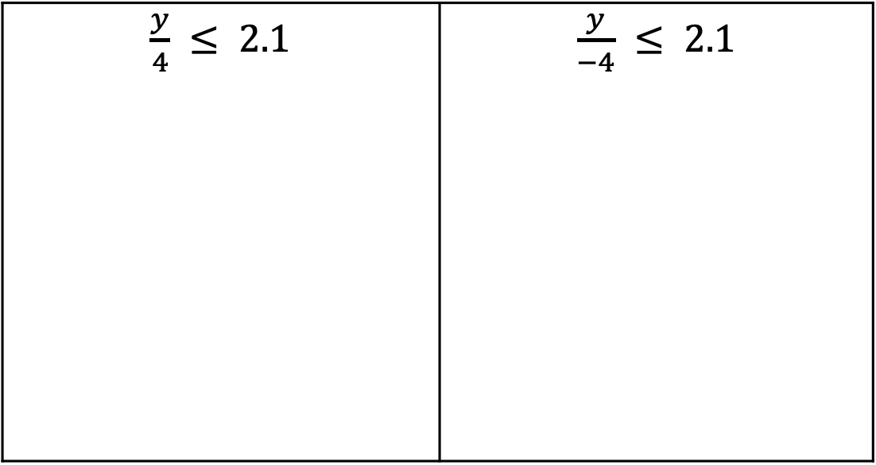
Find the solution to both inequalities using the multiplication property of inequality.
$\frac{y}{4} ≤ 2.1$ | $\frac{y}{−4} ≤ 2.1$
volume 2, pg. 106

Slide 18
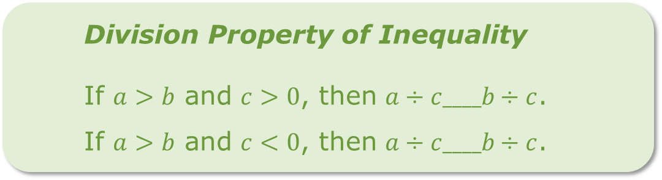
Dividing both sides of an inequality by the same value can be used to solve an inequality by the division property of inequality.
Division Property of Inequality
If $a>b$ and $c>0$, then $a÷c____b÷c$.
If $a>b$ and $c<0$, then $a÷c____b÷c$.
volume 2, pg. 107

Slide 19
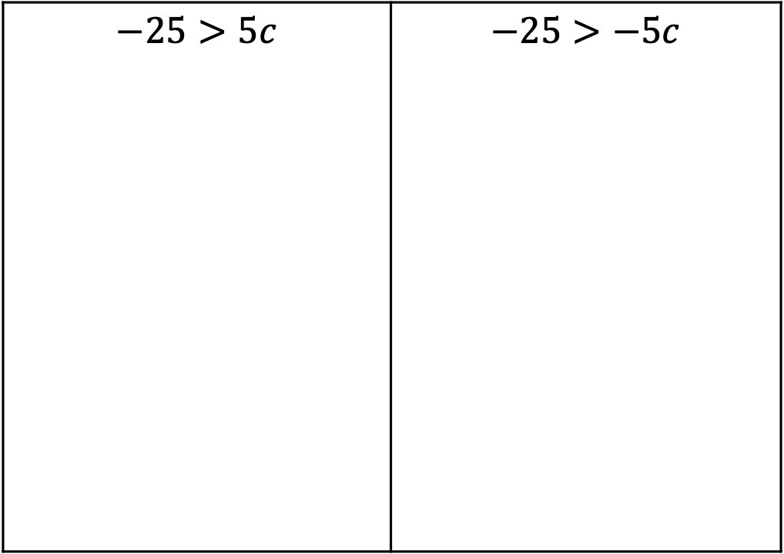
Find the solution to both inequalities using the division property of inequality.
$−25>5c$ | $−25>−5c$
volume 2, pg. 107

Slide 20

Guided Practice
volume 2, pg. 107

Slide 21

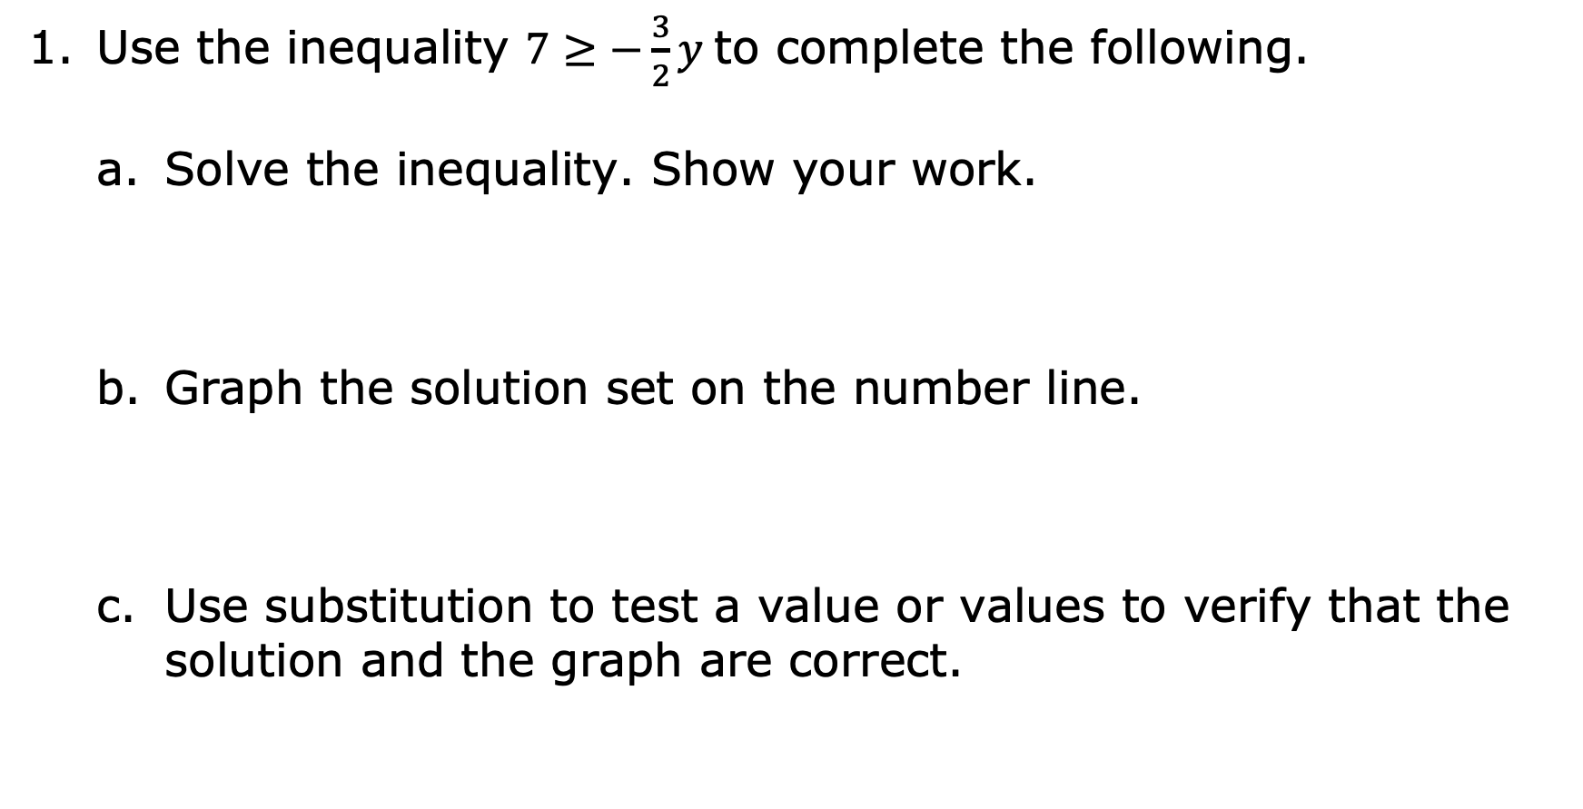
10.4.5 Guided Practice: Solving One-Step Inequalities with Multiplication and Division
Use the inequality $7≥−\frac{3}{2}y$ to complete the following.
Solve the inequality. Show your work.
Graph the solution set on the number line.
Use substitution to test a value or values to verify that the solution and the graph are correct.
volume 2, pg. 107

Slide 22
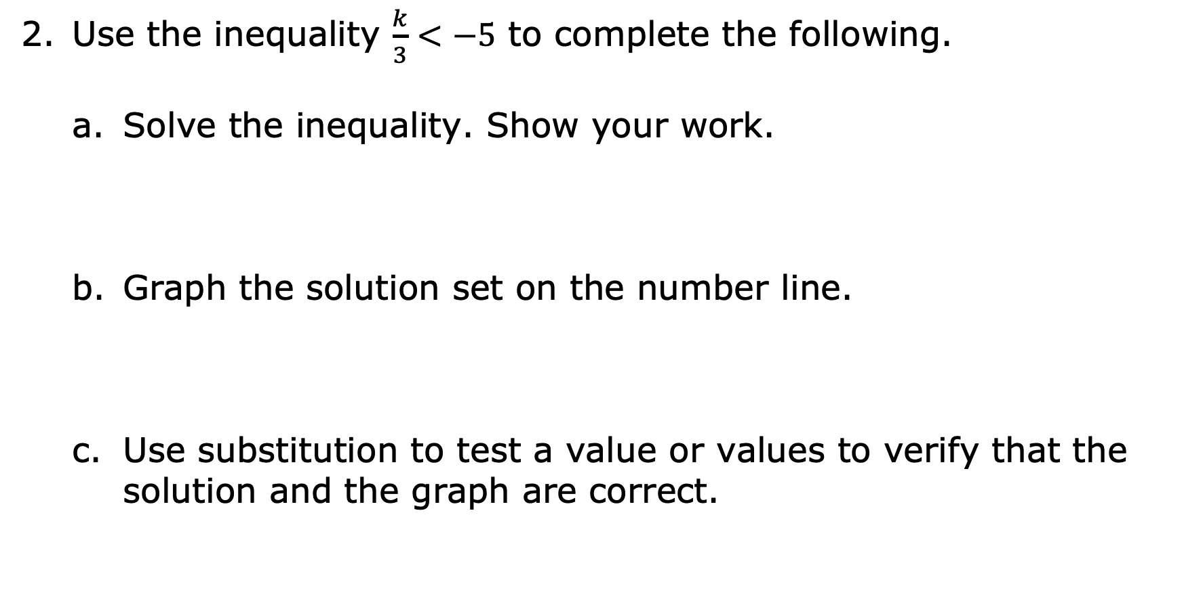
Use the inequality $\frac{k}{3}<−5$ to complete the following.
Solve the inequality. Show your work.
Graph the solution set on the number line.
Use substitution to test a value or values to verify that the solution and the graph are correct.
volume 2, pg. 108

Slide 23
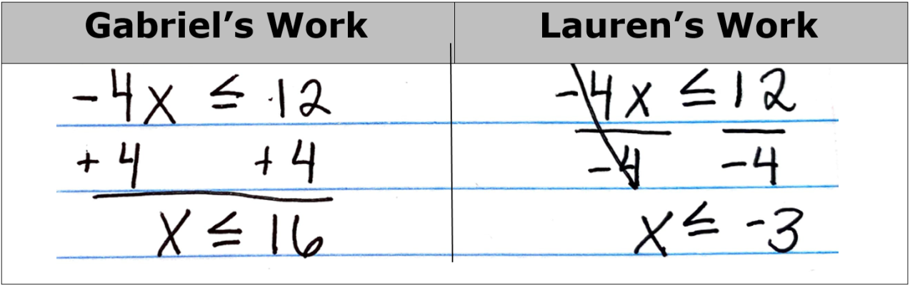
Gabriel and Lauren made errors when solving the inequality $−4x≤12$. Their work is shown.
volume 2, pg. 108

Slide 24

Explain which mistake(s) each student made.
Find the correct solution to $−4x≤12$.
Gabriel’s Error | Lauren’s Error
volume 2, pg. 108

Slide 25

Your Turn
volume 2, pg. 109

Slide 26
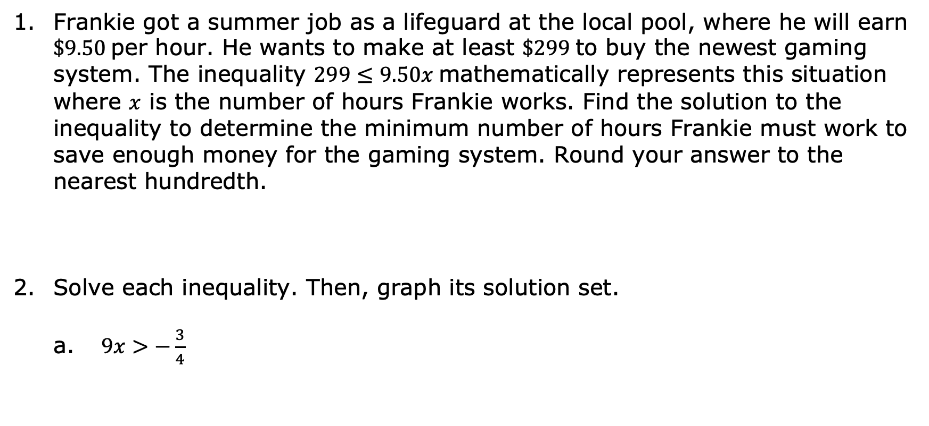
10.4.6 Your Turn!
Frankie got a summer job as a lifeguard at the local pool, where he will earn $\$9.50$ per hour. He wants to make at least $\$299$ to buy the newest gaming system. The inequality $299≤9.50x$ mathematically represents this situation where $x$ is the number of hours Frankie works. Find the solution to the inequality to determine the minimum number of hours Frankie must work to save enough money for the gaming system. Round your answer to the nearest hundredth.
Solve each inequality. Then, graph its solution set.
$9x>−\frac{3}{4}$
volume 2, pg. 109

Slide 27

$5.5≤−\frac{n}{8}$
$−3.6y≤−17.1$
volume 2, pg. 109

Slide 28

Wrap-Up
volume 2, pg. 110

Slide 29
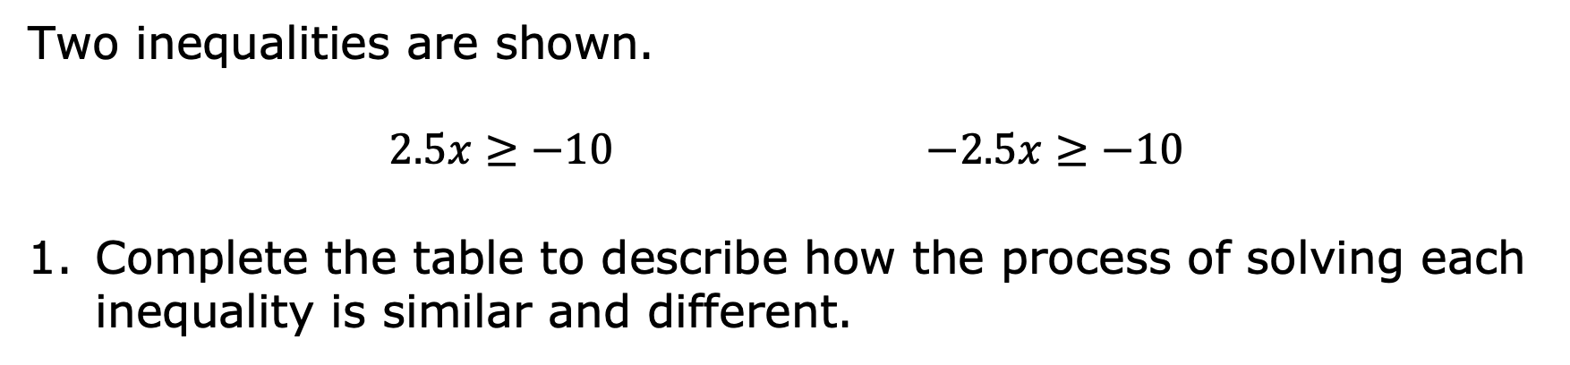
10.4.7 Wrap-Up: Cool Down
Two inequalities are shown.
$2.5x≥−10$ $−2.5x≥−10$
Complete the table to describe how the process of solving each inequality is similar and different.
How is the process of solving each inequality similar? | How is the process of solving each inequality different?
volume 2, pg. 110

